Slide 1
Predicting Tech Salaries:
A Data-Driven Analysis of
U.S. Labor Statistics: P3
DATA 606: Capstone Project
Summer 2025- Dr. Unal Sakoglu
Team A
Dereck Román Rosario
Simran Shah
Gelareh Vakili
Notes:
“We’re Team A, and our project is Predicting Tech Salaries: A Data-Driven Analysis of U.S. Labor Statistics. This is our final Phase 3 presentation. Our GitHub repository contains all code, notebooks, visualizations, and documentation, and is organized for reproducibility.”

Slide 2
Project Repository – DevPay Insights
Project Repository:
GitHub — DevPay Insights
Repository Highlights:
Current Status:
Data cleaning & filtering complete
EDA insights finalized
Feature engineering completed (one-hot encoding, frequency features, standardization)
Ridge Regression baseline established
Random Forest Regressor tuned and evaluated — better performance over baseline
Final deliverables in progress: Phase 3 presentation, updated GitHub content, ICMLDE-format paper
Organized into subfolders: data/, notebooks/, docs/, results/, and src/
Contains full EDA and modeling notebooks for both BLS and Stack Overflow datasets
Environment setup via requirements.txt; repository is MIT licensed
README outlines the project objective, methodology, and dataset usage
Actively maintained by team members: Dereck Román Rosario, Simran Shah, and Gelareh Vakili
Notes:
All of our work has been tracked in a shared GitHub repository called DevPay Insights.
It’s structured for reproducibility with clearly separated folders for data, results, notebooks, and source code. We’ve also included all of our exploratory analysis and modeling in Jupyter notebooks.
Our GitHub repository serves as both the technical record and final deliverable platform for this project. It contains every stage of our workflow and will be updated with final Phase 3 results, ensuring transparency and reproducibility

Slide 3
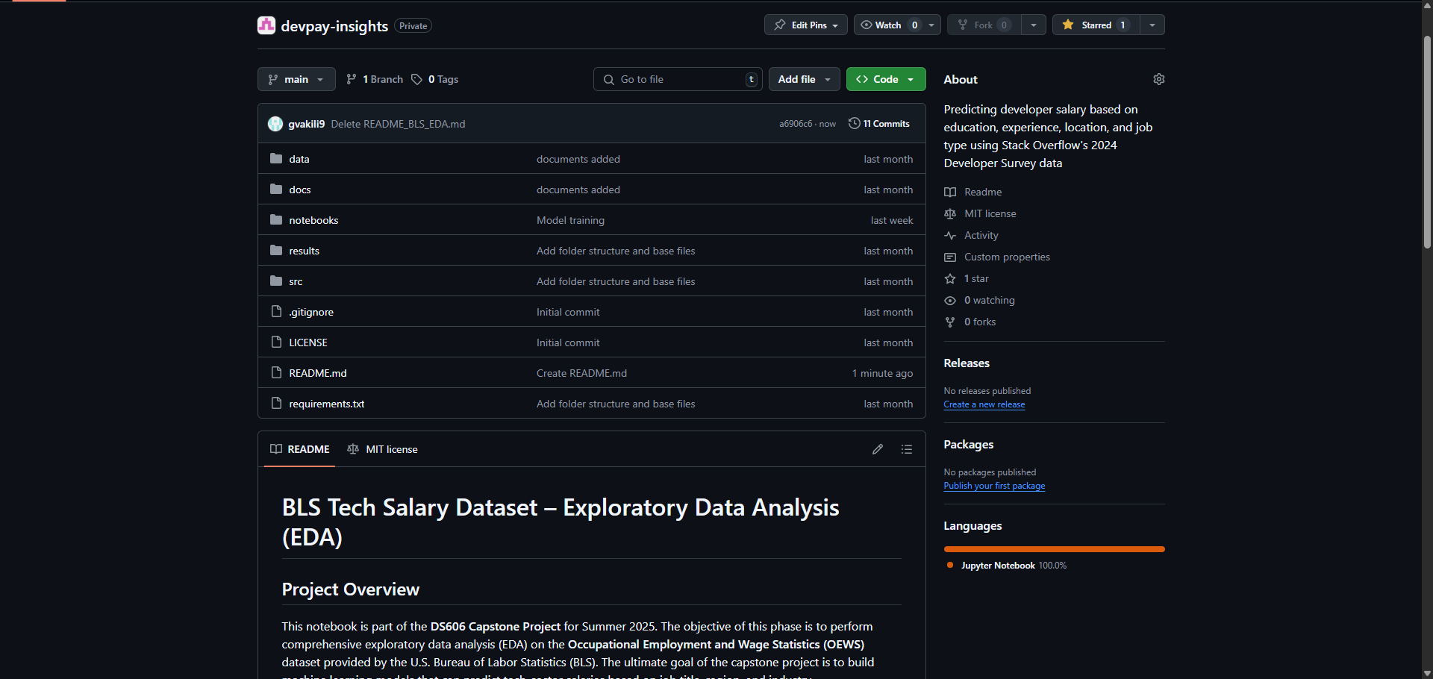
screenshot of the GitHub repo homepage
Notes:
Here’s a visual snapshot of our GitHub repository.
As you can see, the project is titled DevPay Insights, and we’ve kept everything organized and version-controlled.
The README outlines the project scope, methods, and datasets used. This transparency ensures others can understand and replicate our process, which is key for data science best practices.
We’ve kept all relevant files—models, EDA, and outputs—in well-labeled folders for easy navigation.

Slide 4
Project Summary and Machine Learning Task
Project Title:
Predicting Tech Salaries: A Data-Driven Analysis of U.S. Labor Statistics
Objective:
Develop a supervised machine learning model to predict salaries in the U.S. tech sector. The project uses government labor statistics to identify how factors like occupation, industry, and geography influence compensation.
Why This Matters:
Enhances transparency in tech compensation
Informs policy, workforce planning, and career decision-making
Uses standardized, non-self-reported data for model reliability
ML Task:
Type: Regression
Target Variable: Annual median wage (A_MEDIAN, continuous variable, USD)
Outcome: Predict salary across occupations and regions
Notes:
Our objective is to develop a supervised machine learning model that can predict tech salaries in the U.S. using government labor data.
Specifically, we’re analyzing how occupation, industry, and geographic region influence compensation.
This is a regression task, and our target variable is the annual median wage (A_MEDIAN).
By building on standardized public datasets rather than self-reported information, we aim to deliver a more consistent and policy-relevant model.

Slide 5
Primary Dataset: U.S. Bureau of Labor Statistics (OEWS)
Source:
U.S. Bureau of Labor Statistics (BLS)
Download Link
Dataset Properties:
~400,000 records → ~92,000 after filtering for tech-related jobs 32 columns
Covers all U.S. states, territories, and metro regions
Includes wage, employment, occupation, and industry data
Format: Excel (XLSX), government-verified, public domain
Key Variables:
OCC_TITLE: Occupation title
AREA_TITLE: Region
NAICS_TITLE: Industry sector
TOT_EMP: Total estimated employment
A_MEDIAN, A_MEAN: Median and mean annual wage
After Cleaning (for modeling)
17,398 records
27 columns
Notes:
“Our primary dataset is the BLS OEWS, with ~400k records, filtered to ~92k tech jobs, and finally 17,398 for modeling. We also reviewed the Stack Overflow Developer Survey for potential validation. The task is regression, predicting the continuous variable A_MEDIAN — annual median wage.”

Slide 6
What Has Been Done Before?
Existing Approaches:
Stack Overflow Developer Survey: Used in many community dashboards and salary comparison tools; primarily descriptive.
Glassdoor & Levels.fyi Studies: Self-reported data analyzed using simple regression or filtering by job title and location.
BLS Reports: Government publications often visualize wage distributions but lack predictive modeling.
Common Limitations:
Heavy reliance on self-reported data, often international and inconsistent.
Most work is descriptive, lacking predictive or inferential modeling.
Limited integration of structured public datasets like BLS OEWS.
Often uses proprietary, non-generalizable standards
Notes:
A lot of the existing work on tech salaries relies on self-reported data. The Stack Overflow Developer Survey, for instance, powers many dashboards and salary calculators, but it's primarily descriptive—it tells us what respondents earn but doesn’t model the factors behind those earnings.
Similarly, sites like Glassdoor and Levels.fyi use user submissions to show ranges by role and location, but again, that data is often incomplete or skewed by selective reporting.
Even government sources like BLS reports tend to stop at summary statistics and visualizations—they don’t go deeper into predictive modeling.
Across the board, most tools suffer from the same limitations: they rely on self-reporting, they’re lack international reporting or inconsistent, and they rarely make use of structured, public datasets like OEWS.
That’s where our project fills the gap. We're building a predictive model using verified, U.S.-focused, structured data with regional and occupational detail that’s often missing elsewhere.”
“Existing studies often use self-reported, inconsistent data like Stack Overflow or Glassdoor, which are descriptive rather than predictive. BLS reports provide authoritative wage data but rarely apply machine learning. Our work fills this gap with predictive modeling on structured, government-verified data.”

Slide 7
Filling the Gaps: Our Distinctive Approach
Gaps in Prior Work:
Our Contribution:
Optional Extensions:
Minimal use of structured, U.S. government labor datasets in machine learning
Few predictive models using regional and occupational features
Lack of reproducibility in dashboards and survey-based tools
Public, reproducible data: Using the BLS OEWS dataset, which is standardized and verifiable
Predictive Modeling: Implementing regression to forecast salaries across occupations and regions
Feature Engineering: Incorporating geographic, occupational, and industry-level variables Transparent Workflow: Full pipeline documented and version-controlled on GitHub
Clustering occupations and regions
Cross-validating insights with the Stack Overflow Developer Survey (2024)
Notes:
“So how is our work different from what's already out there? First, there's very little predictive modeling done using structured U.S. government labor datasets like OEWS. Most tools are descriptive and rely on survey data, which lacks standardization.
We're addressing that by building a regression model using public, verifiable data that’s updated annually. Our approach incorporates regional, occupational, and industry-level features, which we’ve engineered from raw columns like OCC_TITLE, AREA_TITLE, and NAICS_TITLE.
Everything is version-controlled and documented in our GitHub repo, making our pipeline reproducible and transparent.
Looking ahead, we plan to enhance our model by clustering similar occupations or regions and integrating insights from the Stack Overflow Developer Survey as a secondary reference point. That’ll let us see where crowd-sourced patterns align—or diverge—from standardized labor data.”

Slide 8
EDA Refresher: Key Findings Driving Model Design
Key Insights:
Geographic Variation — States like California, Washington, and New York consistently show the highest median tech salaries.
Occupational Impact — Roles in software development, data science, and systems architecture top the pay scale; support and technician roles fall lower.
Industry Influence — Certain NAICS industry sectors (e.g., information services, software publishing) show higher pay than government or educational sectors.
Employment Concentration — High-paying roles are clustered in urban metro areas with large tech hubs.
Feature Correlation — Strong linear relationship between A_MEAN and A_MEDIAN annual wages confirmed target reliability.
Why It Matters for Modeling:
Validated inclusion of occupation, region, and industry as core predictive features.
Supported one-hot encoding of categorical variables.
Justified non-linear modeling (Random Forest) due to complex geographic–occupational interactions.
Notes:
“Key findings: Salary varies strongly by state, occupation, and industry. California, Washington, and New York lead in pay. Certain tech roles and sectors consistently outpay others. These insights validated using occupation, location, and industry as core features, justifying one-hot encoding and a non-linear model.”

Slide 9
Preparing the BLS OEWS Dataset for Modeling
Cleaning & Filtering Steps
Loaded raw Excel file into a DataFrame using pandas
Dropped rows with suppressed or missing wage and employment data
Filtered out:
Summary/aggregate rows (e.g., “All Occupations”)
Invalid or unknown area codes
Records with placeholder or zero salary values
Standard Occupational Classification (SOC) codes Group Filtering: We filtered only major occupation groups relevant to tech through federal code standards → Example: 15-xxxx = Computer and Mathematical Occupations
Keyword Filtering: We further filtered job titles using tech-related keywords such as “developer,” “engineer,” “data,” “IT,” and “cyber.”
Notes:
“This slide shows how we cleaned and filtered the BLS dataset before modeling.
First, we loaded the raw Excel file using pandas and immediately removed rows with suppressed or missing wage and employment values. We also filtered out non-specific entries like ‘All Occupations’, unknown area codes, and records with zero or placeholder salary values.
Next, we applied two levels of occupational filtering. The first was based on SOC codes—we retained only major groups relevant to tech, such as Computer and Mathematical Occupations, which begin with the code ‘15’.
Then we layered on keyword filtering to catch specific job titles with terms like 'developer', 'engineer', 'data', 'IT', and 'cyber'. This helped us focus on actual tech roles while excluding unrelated fields that might’ve slipped through.
These cleaning steps were essential for improving model accuracy and ensuring we didn’t dilute the dataset with irrelevant roles.”
Standard Occupational Classification

Slide 10
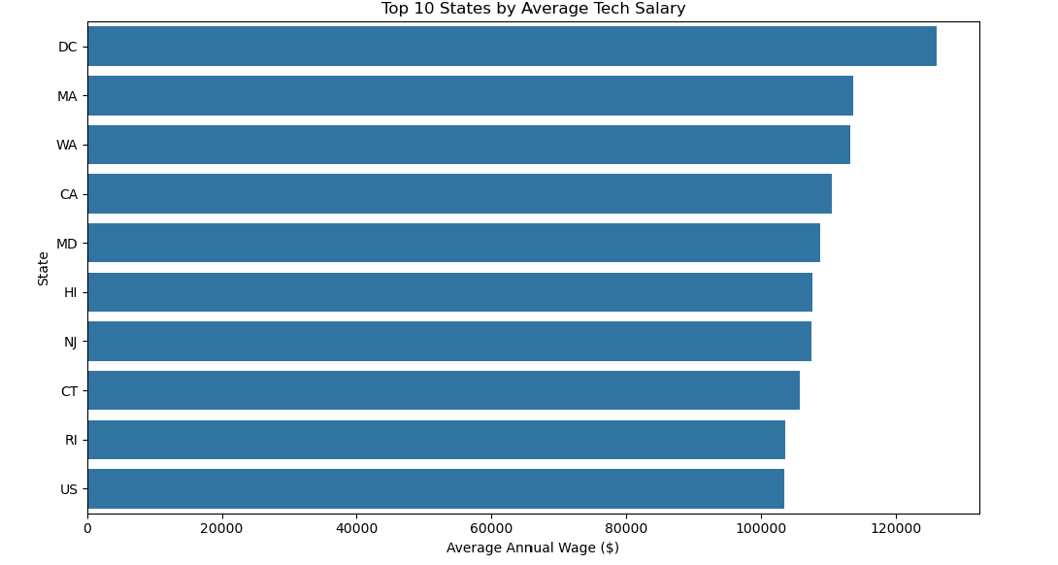
Notes:
“Here we see wage distributions across states, occupations, and industry sectors. Median wage correlates strongly with mean wage, confirming our target’s reliability. These patterns shaped our feature engineering choices.”

Slide 11
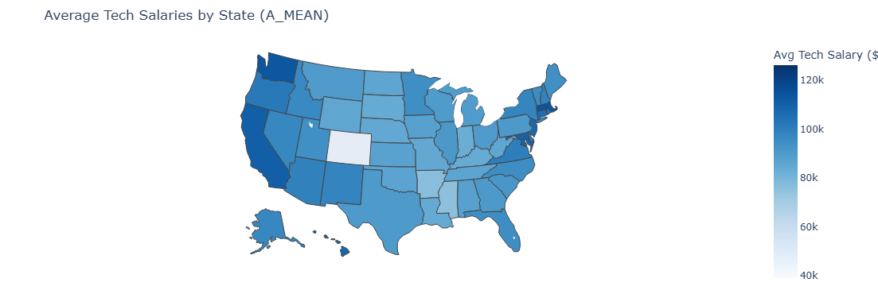
Average Tech Salaries by State
Notes:
“This choropleth map shows the average tech salaries across U.S. states, using the A_MEAN field from the BLS dataset.
As expected, states like California and Washington stand out with higher average salaries—likely due to the concentration of tech hubs and cost of living.
Conversely, some central states reflect lower averages, which might indicate fewer high-paying tech jobs or lower living costs.
This state-level breakdown gave us a clearer picture of geographic wage disparities and will help us evaluate the importance of location in our modeling.”

Slide 12
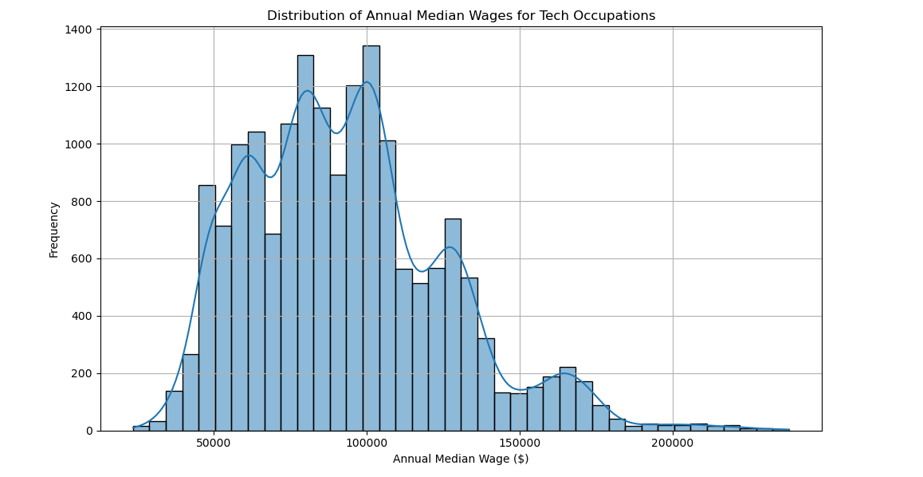
Distribution of Tech Occupation Median Wages
Notes:
“This histogram displays the distribution of annual median wages across tech occupations in the U.S.
As you can see, the majority of wages fall between $80,000 and $120,000, with a noticeable peak just above $100,000. There’s a long right tail showing higher-wage roles, likely representing specialized or senior-level positions.
The slight dips or gaps may correspond to suppressed or less frequently reported occupations, but overall the distribution appears relatively normal with a positive skew.
This visualization helped us validate salary consistency and informed our approach to outlier detection and normalization for modeling.”

Slide 13
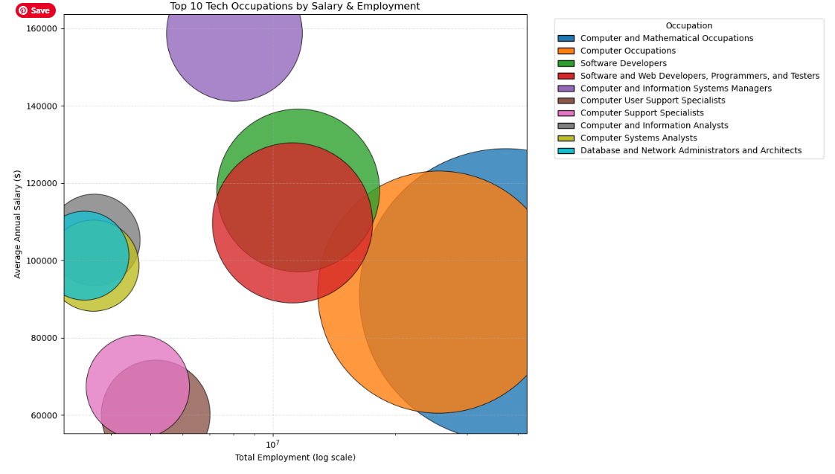
Top 10 Tech Occupations by Salary & Employment
Notes:
“This bubble chart illustrates the top 10 tech occupations, showing the relationship between total employment (on the x-axis) and average annual salary (on the y-axis).
Each bubble’s size represents the number of employees, while color indicates the occupation category.
We can see that some roles, like Software Developers and Computer Systems Analysts, have both high employment and strong salaries, making them central to the tech job market.
On the other hand, certain niche roles show high salaries but relatively low employment, which may point to specialized skill sets or limited demand.
This visualization helped us identify which job titles carry the most predictive weight for our salary model and informed our feature selection process.”

Slide 14
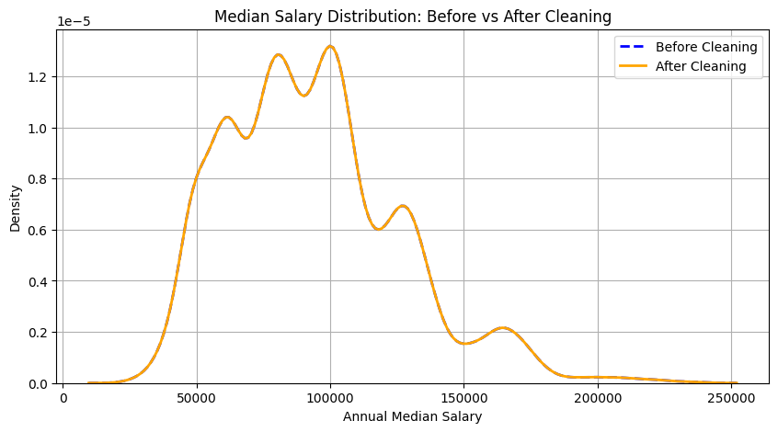
Preparing the BLS OEWS Dataset for Modeling
After Cleaning:
Unique job titles before cleaning: 29
Unique job titles after cleaning: 29
KDE plot, before and after cleaning was plotted, the shape and range of the distribution remain consistent, confirming that we did not lose valuable salary insights during the cleaning process.
Notes:
“After cleaning, we wanted to validate that we didn’t accidentally lose meaningful salary data or distort the distribution.
The line chart here is a KDE plot comparing the distribution of annual median wages before and after cleaning. As you can see, the shapes are nearly identical, which means we retained the full range and character of the original salary data.
Also, we confirmed that the number of unique tech job titles remained stable—29 both before and after cleaning.
This validation step gave us confidence to move forward with modeling, knowing our dataset was both clean and representative.”

Slide 15
Preparing the BLS OEWS Dataset for Modeling
Feature Selection:
Kept modeling-relevant fields:
OCC_TITLE (occupation)
AREA_TITLE (location)
NAICS_TITLE (industry)
TOT_EMP (employment count)
A_MEDIAN / A_MEAN (target variables)
Prepared categorical variables for encoding:
Grouped overly specific titles into broader categories
Reserved space for encoding via one-hot or label methods
Notes:
“Once we cleaned the dataset, we focused on selecting only the features relevant for modeling.
We kept key columns like OCC_TITLE for job title, AREA_TITLE for region, and NAICS_TITLE for industry sector. We also retained TOT_EMP for employment estimates and our target variables: A_MEDIAN and A_MEAN salary.
Since many of these are categorical, we planned for encoding. For example, very specific job titles were grouped into broader occupation categories so we could simplify the input space.
We reserved the next stage of preprocessing for applying one-hot or label encoding depending on what worked best for our chosen models.”

Slide 16
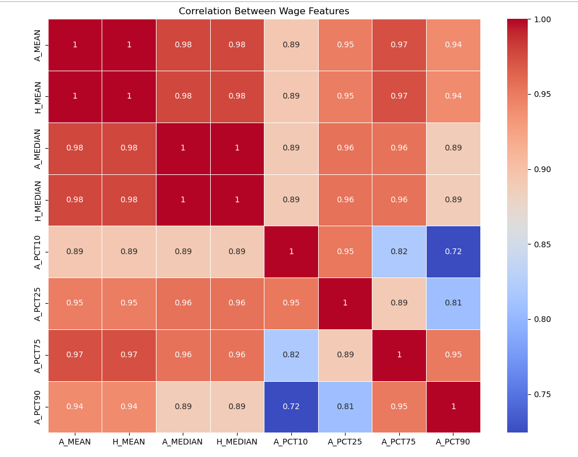
Exploring Tech Salary & Employment Patterns
Cleaned dataset used to analyze salary trends across U.S. tech occupations and regions
Visualized distributions, correlations, and regional disparities
Confirmed strong linear relationships between wage fields (e.g., A_MEAN, A_MEDIAN)
Notes:
“Here we began our exploratory analysis of the cleaned tech dataset. The goal was to understand how salaries vary across occupations, regions, and other structural factors.
The correlation heatmap shown here helped us verify redundancy and relationship strength between our main salary features — for example, A_MEAN and A_MEDIAN are nearly perfectly correlated, so we considered retaining only one for modeling to reduce multicollinearity.
Additionally, some percentile-based wage fields had lower correlations with each other and with the median and mean, which might offer complementary information during feature selection or clustering.
This step was key to confirming our dataset’s internal consistency before we moved into modeling.”

Slide 17
Modeling Approach and Training Process
Target variable & Models Trained
Features used
A_MEDIAN (annual median wage)
Ridge Regression
Random Forest Regressor
Encoded:
OCC_TITLE,
AREA_TITLE,
NAICS_TITLE,
TOT_EMP
Data split
Feature encoding
Training: 70%
Validation: 15%
Testing: 15%
One-hot for categorical features
Notes:
“We split data 70/15/15. Ridge Regression served as our baseline, Random Forest as our main model. Random Forest achieved lower RMSE on both validation and test sets, capturing non-linear feature interactions missed by Ridge.”

Slide 18
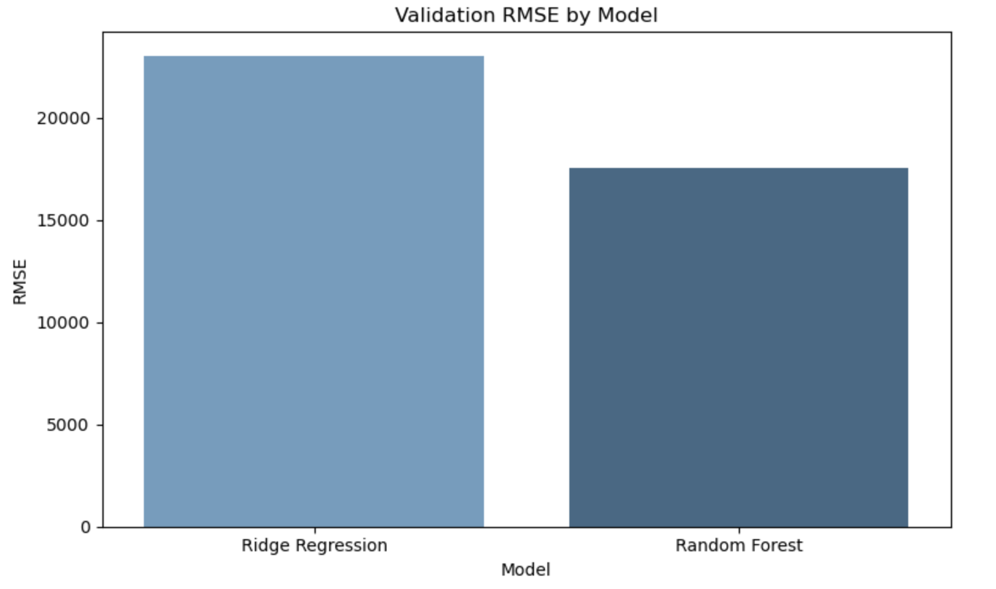
Model Iteration & Selection
Model | Key Characteristics | Validation RMSE ($) | Test RMSE ($) | Notes / Outcome
Ridge Regression | Linear model with L2 regularization | 29,922.20 | ~23,031 | Established baseline; underfit complex patterns
Random Forest | Ensemble of decision trees, non-linear relationships | 17,495.56 | 17,502.32 | Best performance; captures geographic–occupational interactions
Why Random Forest Was Selected:
Handles non-linear relationships between features and salary.
Robust to outliers in salary data.
Naturally ranks feature importance, aiding interpretation.
Lower RMSE on both validation and test sets compared to Ridge.
Notes:
“We began with Ridge Regression as a baseline, knowing it would capture linear patterns but might miss more complex interactions. Random Forest outperformed Ridge in both validation and test RMSE, demonstrating stronger generalization and interpretability. The model’s ability to rank features also supports our Phase 3 interpretation goals.”

Slide 19
Model Performance & Comparison
Metric Used: Root Mean Squared Error (RMSE)
Validation Results:
Ridge Regression: RMSE = 29,922.20
Random Forest: RMSE = 17,495.56
Ridge Cross-Validation (5-Fold):
Mean RMSE = 31,261.60
Test Set Performance:
Random Forest Test RMSE: 17,502.32
Notes:
“We evaluated two models—Ridge regression and Random Forest—using RMSE as our primary metric because it emphasizes larger prediction errors, which is critical for wage prediction.
Ridge regression gave us a validation RMSE of around 29,922, but its 5-fold cross-validation average was slightly higher at about 31,262. In contrast, the Random Forest model performed significantly better, with a validation RMSE of 17,495 and a test RMSE of 17,502, indicating consistent performance across datasets.
We used 5-fold cross-validation with Ridge regression to ensure robustness. This helps reduce variance and validate model performance across different splits.
These results show that Random Forest is currently our best-performing model, likely due to its ability to capture complex, nonlinear relationships that Ridge regression may miss.”

Slide 20
From Baseline to Best Model: Iteration Process
01
Data Cleaning (Remove missing & Invalid entries)
02
Feature Engineering (One-hot encoding, frequency features, standardization)
03
Data Split (70% Train/15% Validation/15% Test)
04
Model Training
Ridge Regression (Baseline)
Random Forest (Main)
05
Evaluation (RMSE, residuals, feature importance)
06
Model Selection ( Random Forest chosen)
Notes:
“This diagram summarizes our workflow from cleaning and feature engineering to training, evaluation, and model selection.”

Slide 21
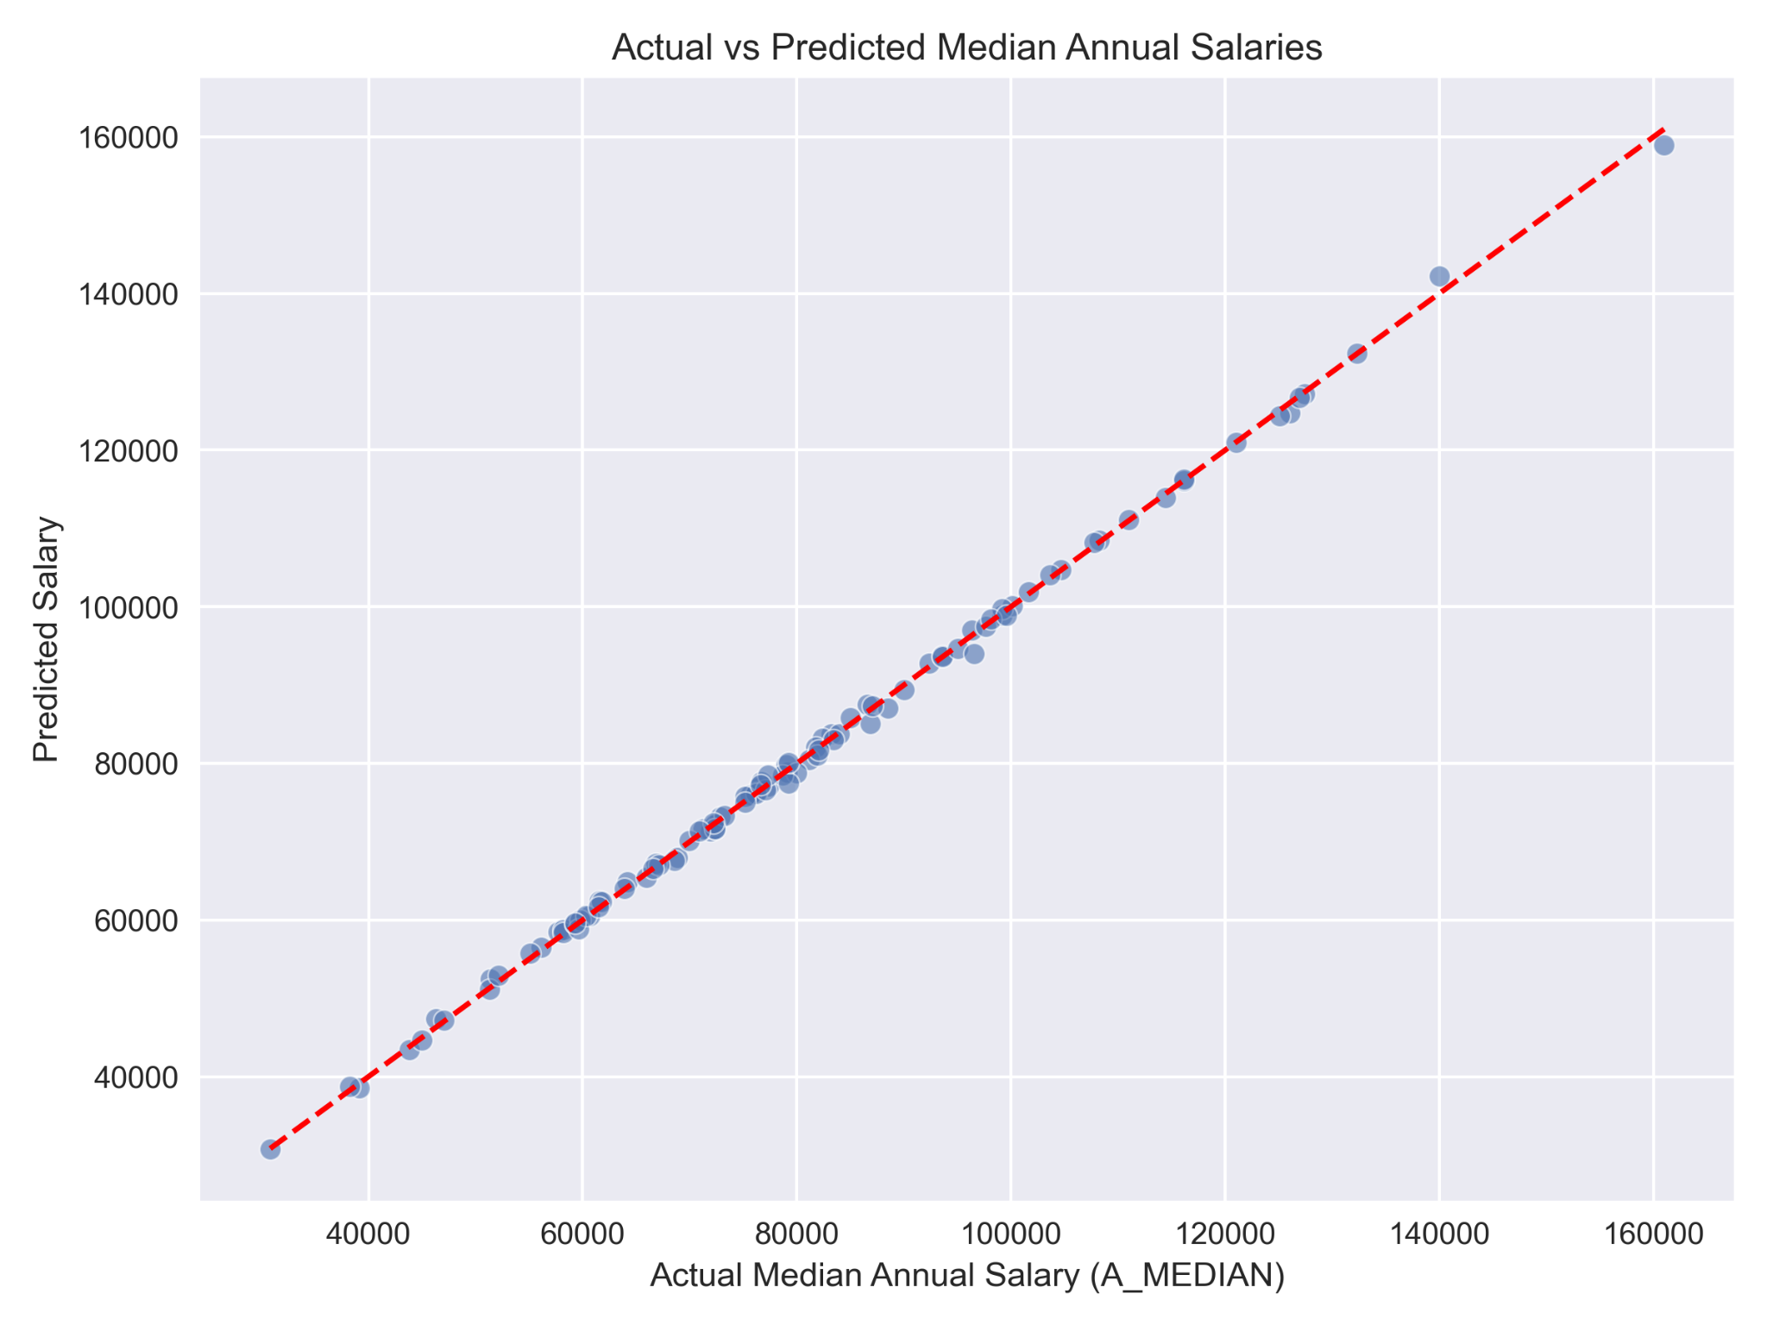
Ridge Model Performance Visualization
Notes:
“Residual plots show our model predicts mid-range salaries accurately but underestimates very high salaries, a common effect of skewed wage distributions. RMSE stayed consistent between validation and test sets, showing good generalization.”
“Here are some of the visualizations that we’re using to further evaluate the performance of the models. For the Ridge regression we plotted the actual salaries against our predictions in order to visualize the accuracy of our model and try to visually detect potentially bad regularization strength, see if there were particular ranges where the model performed better or worse, and identify outliers that could suggest that our model is missing robustness in capturing behaviours in the data.”

Slide 22
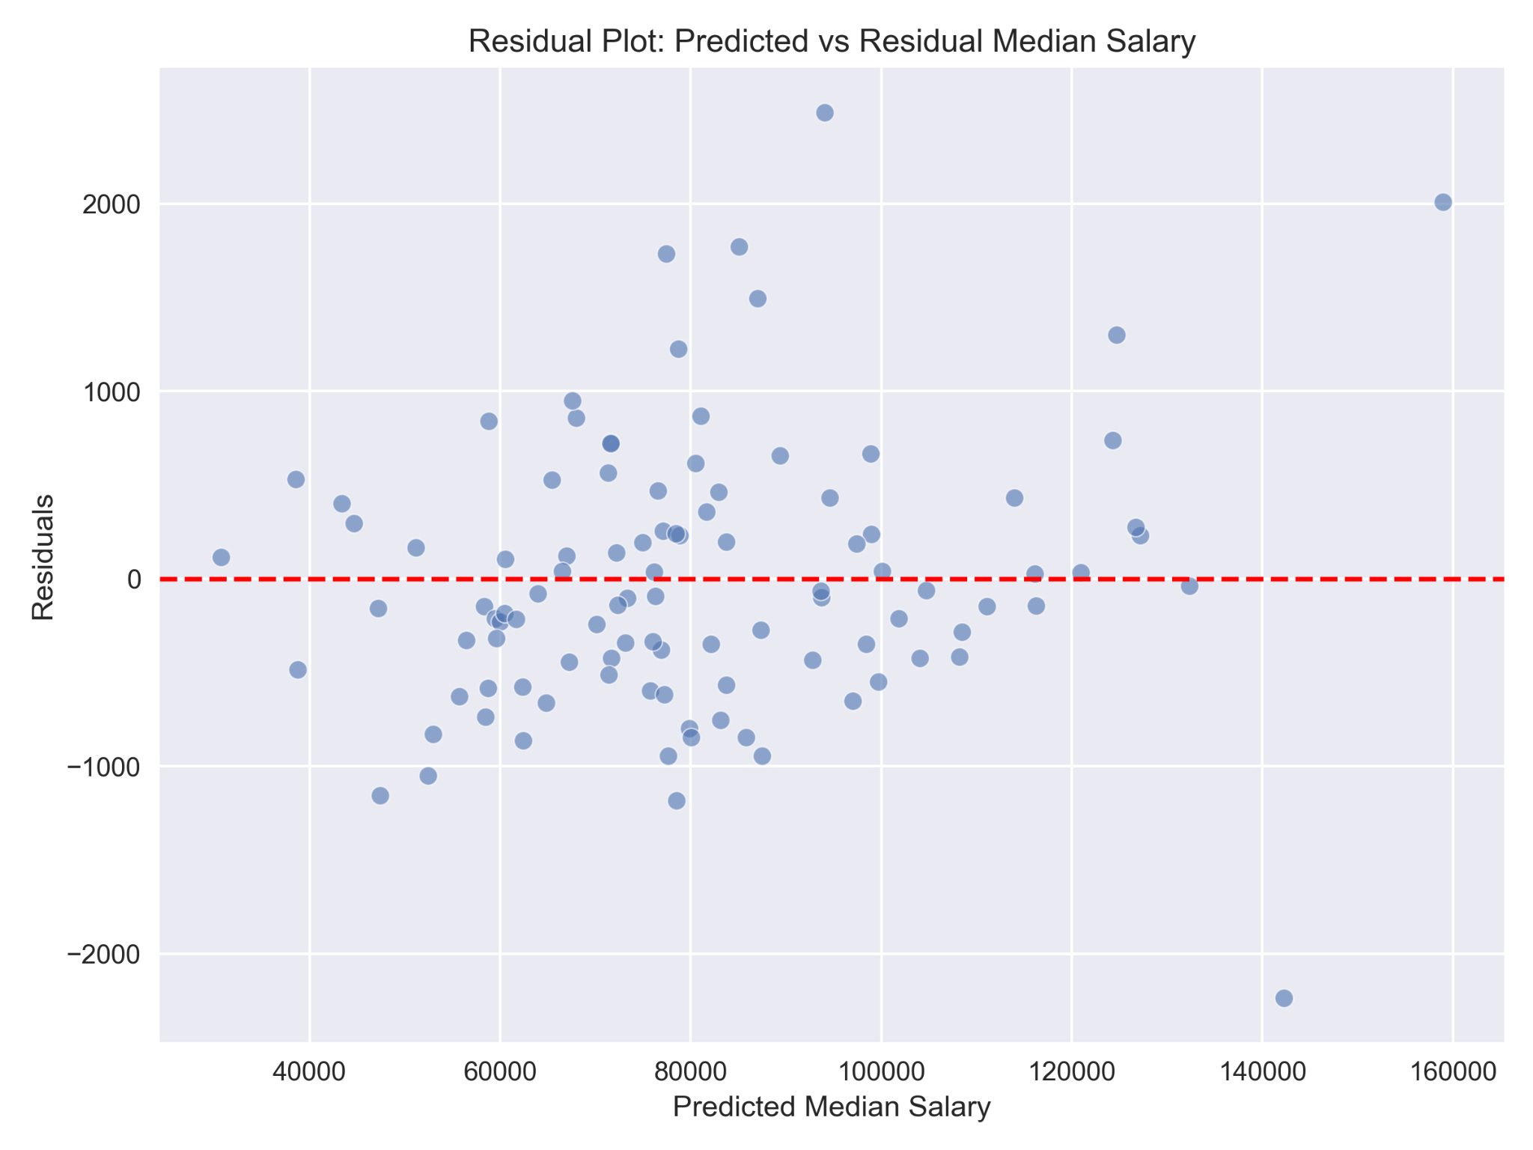
Ridge Model Performance Visualization
Notes:
“Additionally, our next visualization to evaluate model performance was to plot the predicted values against the residual for each salary prediction. As the residuals are defined as the difference between our actual salary values and our predicted values, a plot like this can validate the linearity and constant variance assumptions necessary to run a ridge model, and function as an additional visual method to identify potential outliers and bias from regularization in order to improve model performance in phase 3.”

Slide 23
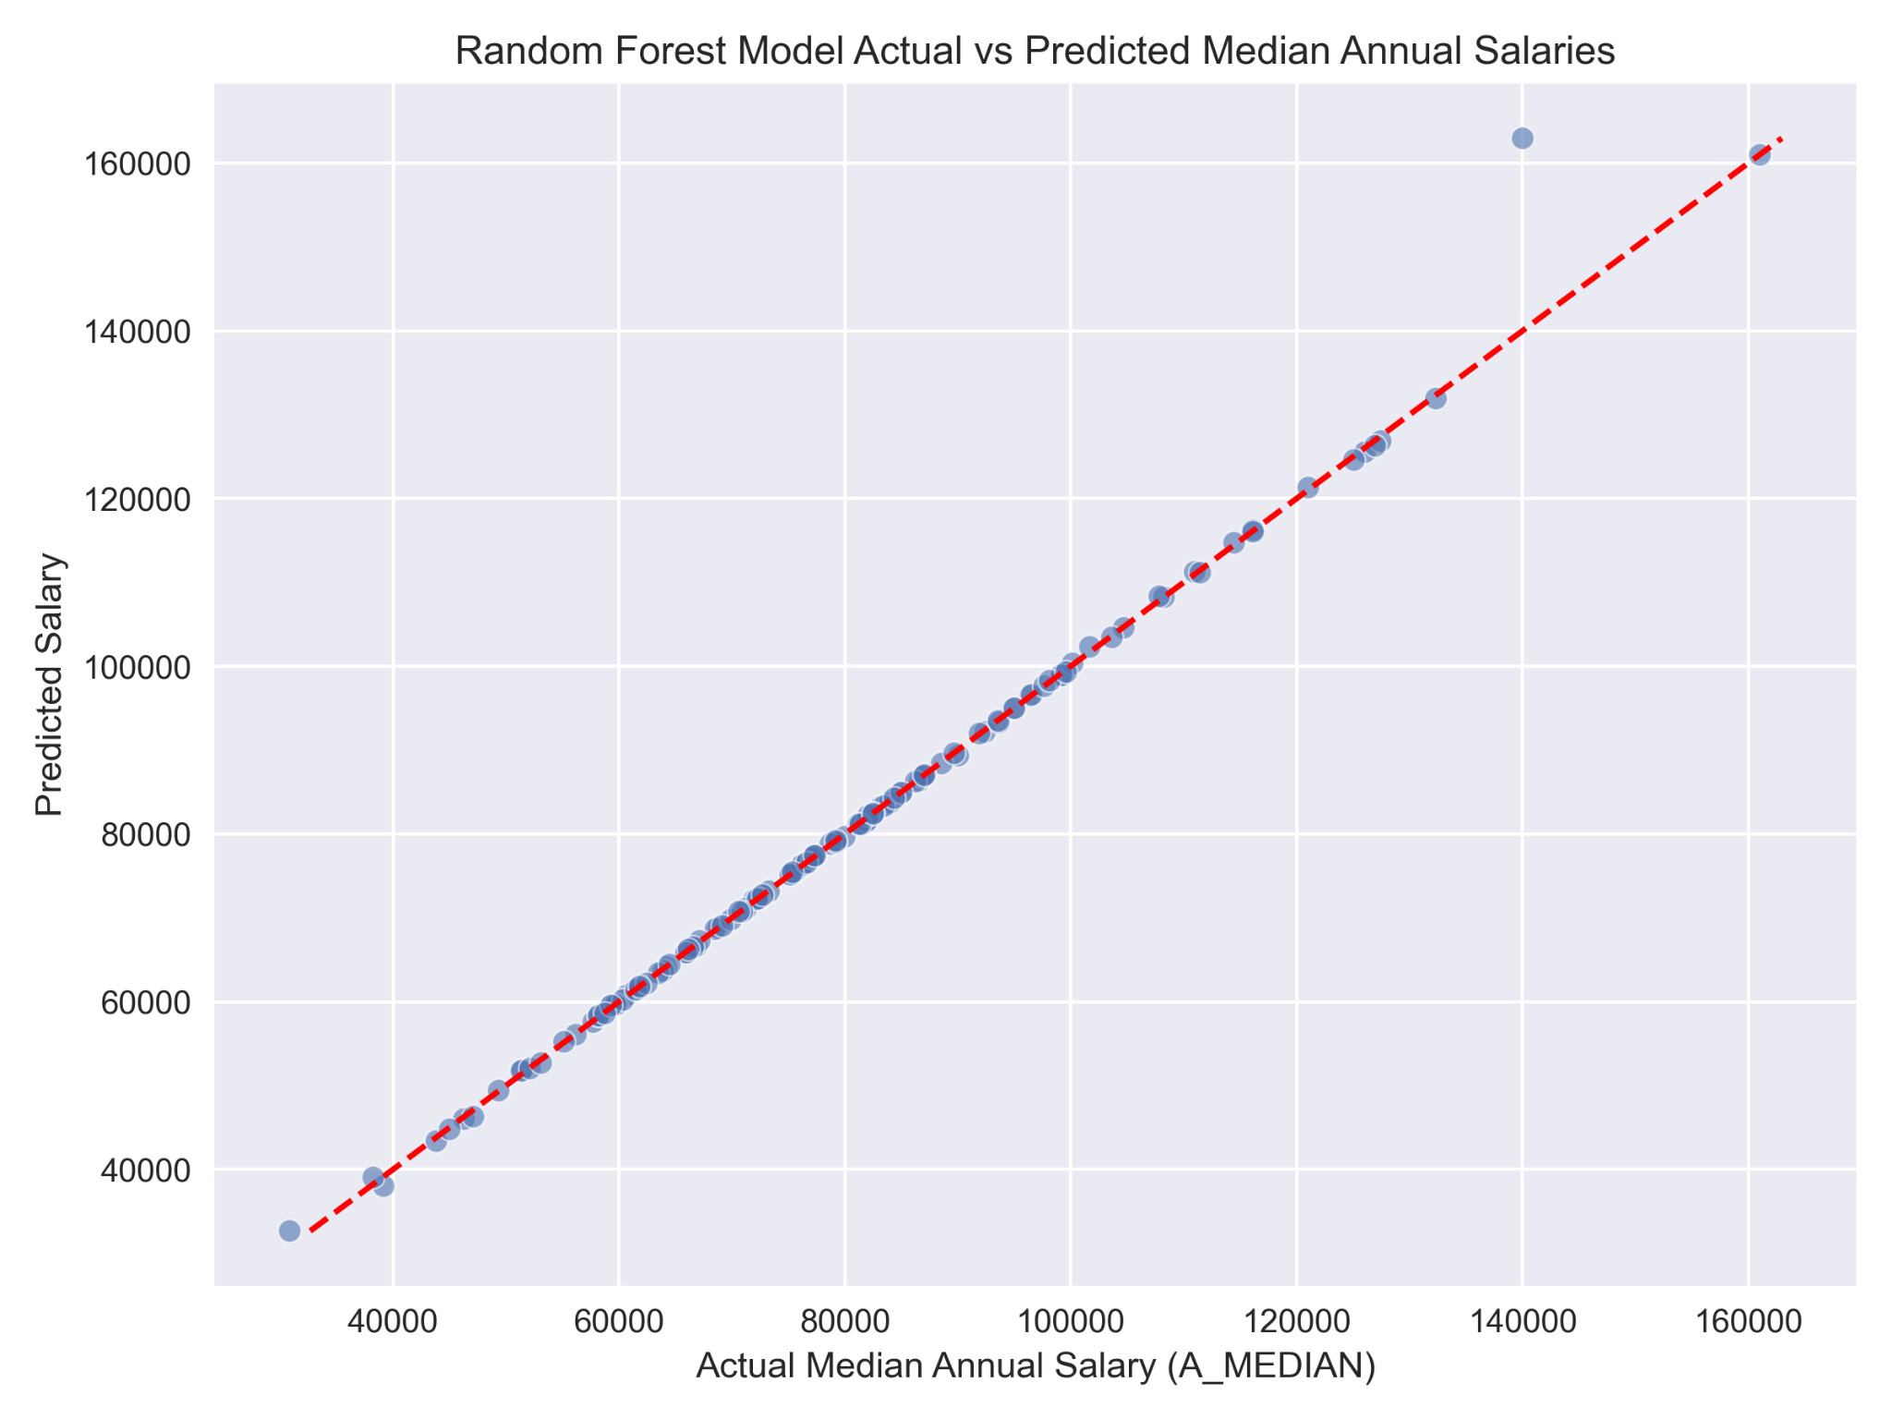
RF Model Performance Visualization
Notes:
“We are also using a random forest model in this project, and as it could prove insightful to compare and contrast these models not just against themselves but pre-existing attempts at salary prediction, we performed the same operations and created the same plots for the random forest model as well. Again a plot like this will help in detecting bias in predictions, checking for potential fit issues, and having a visual method to compare model performance. In contrast to ridge regression, this plot shows that we have less clustering around the 80k salary range, but also have a more noticeable outlier in the higher range, indicating that there is more work to be done in improving model performance.”

Slide 24
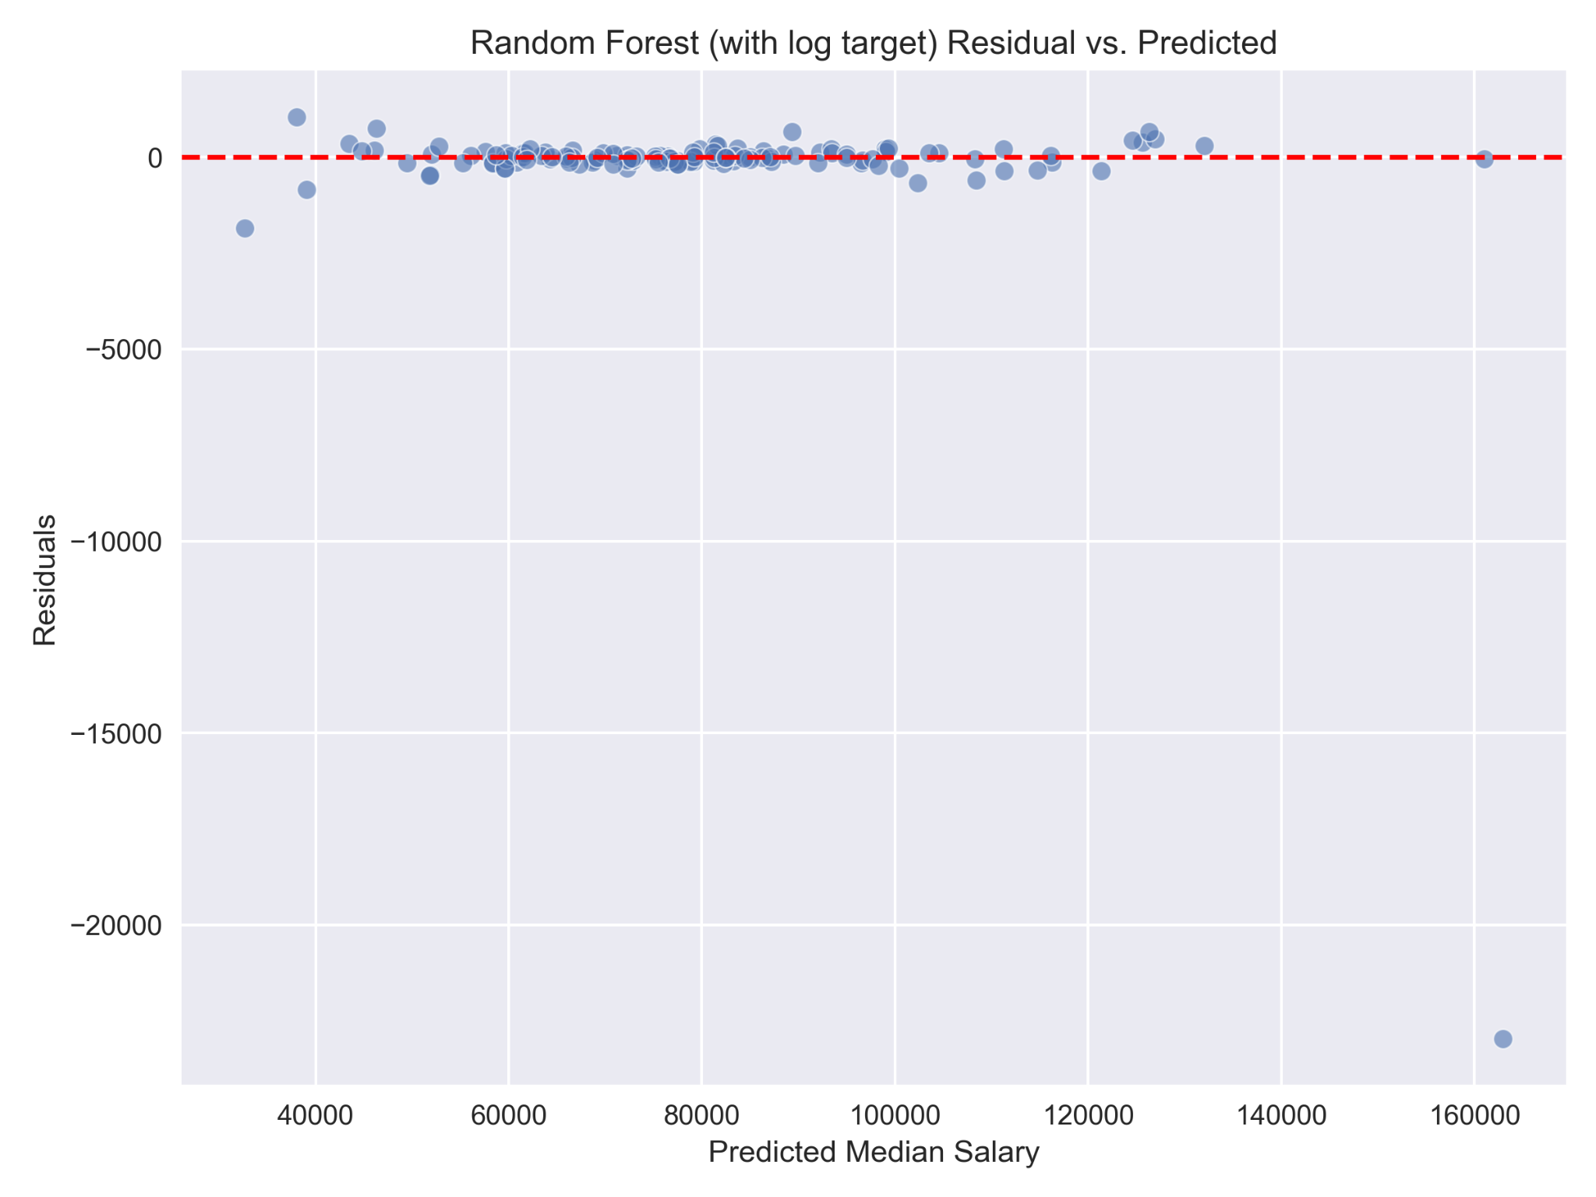
RF Model Performance Visualization
Notes:
“This was one of the more interesting visualizations to come out of preliminary model evaluation. Like with ridge regression, plotting the residual vs predicted salary allows for a method to detect prediction bias, check variance consistency, and most importantly here – identifying outliers. As you can see there is not only a very clear outlier at the higher end of the salary range but potentially other outliers at the lowest end as well, although the high range outlier skews the plot so much it becomes difficult to tell for the other points. This clearly indicates that more work is needed, either data cleaning (addressing something we may have missed), or potential model adjustments for improvement.”

Slide 25
Interpretation & Key Insights
Feature Importance (Random Forest):
Model Behavior:
Real-World Takeaways:
Occupation Title (OCC_TITLE) — strongest predictor of salary. Region (AREA_TITLE) — major driver of wage variation. Industry Sector (NAICS_TITLE) — certain sectors consistently outpay others. Employment Size (TOT_EMP) — smaller correlation; high employment areas not always high-paying.
Underestimates extreme high salaries — typical in tree-based models without log-transforming skewed targets.
Handles mid-range salaries well, with residuals clustered near zero.
Non-linear feature interactions captured — e.g., high-paying roles in specific regions amplified salary predictions.
Geographic and occupational targeting could inform policy decisions and career planning.
Industry choice plays a significant role in potential earnings.
Data-driven approach improves over self-reported salary estimates.
Notes:
“Occupation is the strongest predictor, followed by location and industry. Employment size is less correlated. Geographic and occupational targeting can inform policy and career planning. Industry choice significantly impacts earning potential.”

Slide 26
What We’ve Done and Why It Matters
Built a fully reproducible machine learning pipeline using public, government-verified U.S. labor data.
Conducted comprehensive exploratory analysis of salary trends across tech occupations, industries, and regions.
Constructed and evaluated baseline and advanced regression models, selecting Random Forest for its superior performance.
Identified key drivers of salary variation and quantified disparities by role, location, and industry sector.
Delivered actionable insights that can inform policy decisions, workforce planning, and career guidance.
Notes:
“We built a reproducible pipeline using verified U.S. labor data, analyzed salary trends across tech roles, industries, and regions, and tested multiple regression models, selecting Random Forest for its strong performance. This work reveals key drivers of salary variation and provides insights useful for policy, workforce planning, and career guidance.”

Slide 27
What Could Be Done Differently / Next Steps
Model Enhancements: While our Random Forest model delivered strong performance, there are areas where it could be refined. Integrating the Stack Overflow Developer Survey could provide a valuable comparison with self-reported salary data. Advanced ensemble algorithms such as XGBoost or LightGBM may offer additional performance gains. Applying a log transformation to the target variable could help address skewness and improve predictions for extreme high salaries. More comprehensive hyperparameter tuning with expanded search methods could further optimize results.
Feature Engineering Improvements: Salary predictions could be strengthened by including cost of living indices to normalize location-based differences. Additional features, such as education level and years of experience, could be incorporated from external datasets. Interaction terms between occupation and industry could help capture combined effects that influence compensation.
Extended Analyses: Although outside the scope of this project, additional analyses could add value. Clustering could identify natural groupings of occupations and regions with similar pay characteristics. If multi-year BLS data were available, time-series analysis could uncover salary trends over time. An interactive dashboard could also make the model’s predictions and insights more accessible to a broader audience.
Notes:
“Our model performed well, but there’s room to refine it. We could test advanced algorithms like XGBoost, add cost of living and experience data for richer predictions, and apply transformations to better handle extreme salaries. Additional analyses, like clustering and time-series trends, could provide deeper insights, and an interactive dashboard would make our results more accessible to policymakers and job seekers.”
“Future refinements could include integrating cost of living indices, education and experience data, and advanced algorithms like XGBoost. Additional analyses like clustering or trend analysis could add depth, and an interactive dashboard could make results more accessible.”

Slide 28
Data Sources & Supporting Materials
Datasets:
U.S. Bureau of Labor Statistics (OEWS 2024) https://www.bls.gov/oes/special-requests/oesm24all.zip
Stack Overflow Developer Survey 2024 https://survey.stackoverflow.co/datasets/stack-overflow-developer-survey-2024.zip
Tools & Libraries:
Python 3.11, Pandas, NumPy, Seaborn, Matplotlib, Scikit-learn
Jupyter Notebook, GitHub
Background Reading:
Pedregosa et al. (2011). Scikit-learn: Machine Learning in Python. Journal of Machine Learning Research.
Stack Overflow Insights. (2024). Developer Survey Results.
U.S. Department of Labor. (2024). Occupational Employment and Wage Statistics (OEWS).
Glassdoor. (2024). Glassdoor Salary Reports. Retrieved from https://www.glassdoor.com
Levels.fyi. (2024). Levels.fyi Compensation Data. Retrieved from https://www.levels.fyi
Notes:
“All datasets, tools, and literature used are cited here. Thank you — we welcome any questions.”

Slide 29
Thank you
Questions?
Notes:
“Thank you for your time and attention. We hope this work sparks meaningful discussion and look forward to your feedback!”

